Slide 1



X
Sales Performance Analysis
Kimia Farma - Big Data Analytics
Presented by
Wahyu Tejakusuma Kalpikajati

Slide 2





Wahyu Tejakusuma Kalpikajati
I am an undergraduate Management student at Universitas Sebelas Maret Surakarta, actively involved in various organizations. I am passionate about learning new things and constantly improving myself. I possess strong decision-making, leadership, and analytical skills, which I have developed through both academic and extracurricular activities.
Klaten, Central Java, Indonesia
wahyuukusuma1704@gmail.com
Wahyu Tejakusuma Kalpikajati

Slide 3

About Company
Kimia Farma was established in 1817, making it one of the oldest pharmaceutical companies in Indonesia. Originally founded as a small drugstore by the Dutch East Indies colonial government, it has since evolved into a leading pharmaceutical company in the country. Over the years, Kimia Farma has expanded its operations to include the production, distribution, and retail of pharmaceuticals, health supplements, and medical devices. With a commitment to improving public health, Kimia Farma has grown into a trusted name in the healthcare industry, operating through a network of pharmacies, clinics, and distribution channels across Indonesia.
Kimia Farma is one of Indonesia's leading pharmaceutical companies, specializing in the production, distribution, and retail of pharmaceutical products, health supplements, and medical devices. Established in 1817, Kimia Farma has a long history of contributing to the healthcare sector, providing high-quality products and services that meet the needs of the Indonesian community. The company operates through a network of pharmacies, clinics, and distribution channels, with a strong commitment to improving public health and well-being.

Slide 4
Project Portfolio
The Big Data Analytics project at Kimia Farma focuses on utilizing data-driven insights to optimize business processes and enhance decision-making across various functions. As a leading pharmaceutical company in Indonesia, Kimia Farma has accumulated vast amounts of data from transactions, product inventories, and branch performance. However, there is a need to better analyze and leverage this data to drive improvements in sales performance, operational efficiency, and customer understanding. The project aims to aggregate and analyze data from four key datasets: transaction details from kf_final_transaction.csv, inventory data from kf_inventory.csv, branch information from kf_kantor_cabang.csv, and product data from kf_product.csv. The objective is to uncover patterns and trends that can help Kimia Farma make more informed decisions, identify growth opportunities, and enhance overall performance. The key challenge lies in transforming this data into actionable insights that can support the company's strategic goals and improve its competitive advantage in the pharmaceutical market.

Slide 5
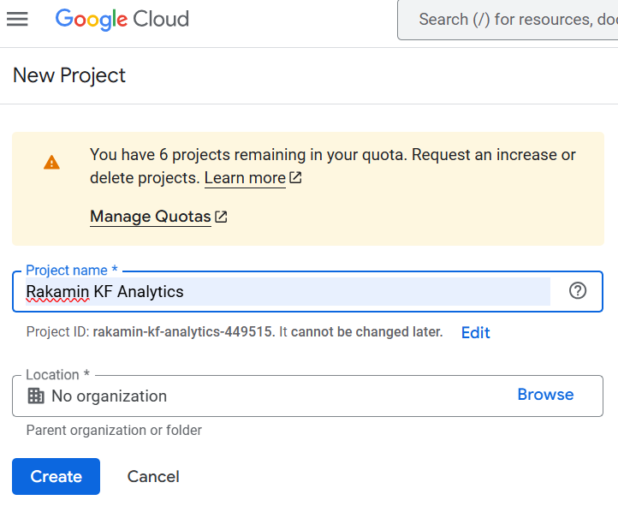
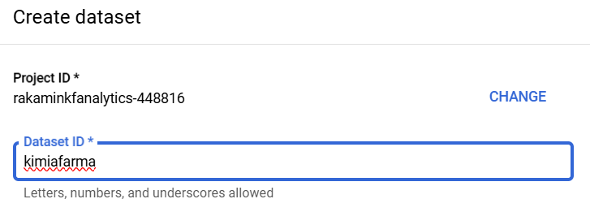
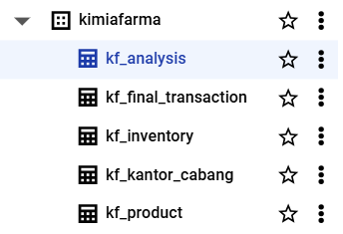
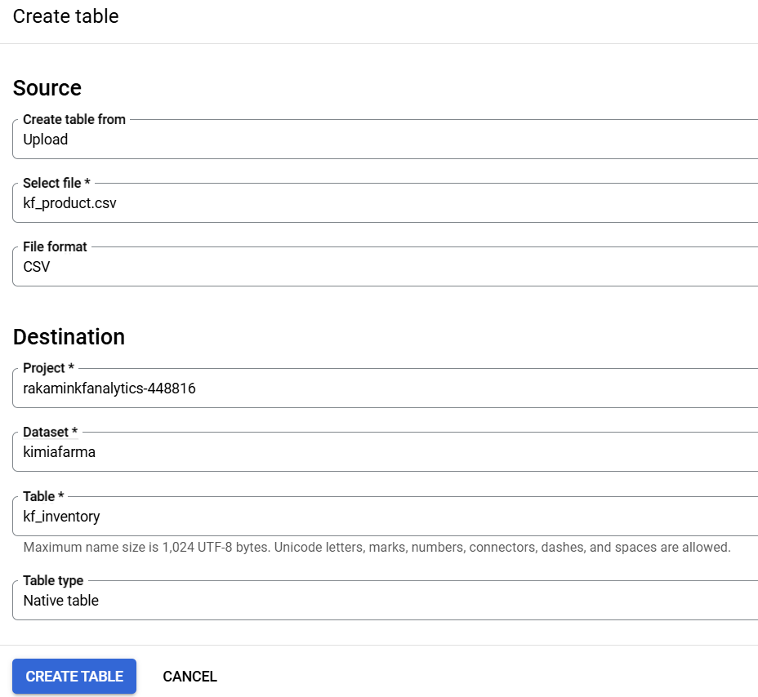
Importing Dataset to BigQuery
The process starts with preparing the dataset, followed by creating a GCP project ('Rakamin KF Analytics') and opening the BigQuery Console. Next, the user creates a dataset ('kimiafarma') and imports data into BigQuery. After importing, they verify the data and perform data validation. Finally, the user runs an SQL query to create a new table for further analysis.

Slide 6
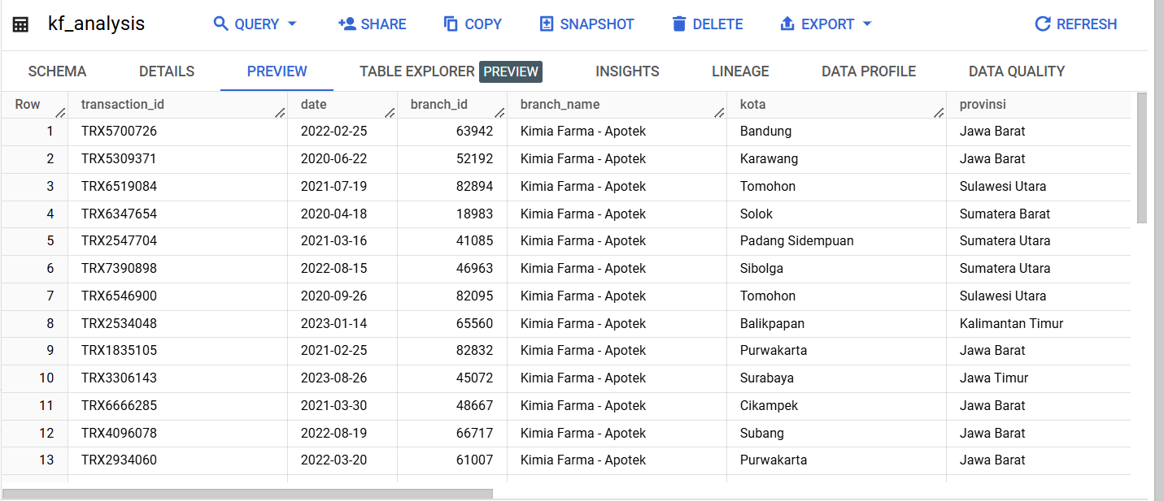
Tabel Analisa
This BigQuery table records transactional data for Kimia Farma - Apotek, tracking sales across multiple branches. It helps analyze sales trends, seasonal patterns, and branch performance by comparing transaction volumes across regions. The data also provides insights into market distribution, operational efficiency, and potential anomalies. When integrated with product and customer data, it enables deeper analysis of purchasing behavior and inventory optimization, supporting data-driven decision-making for business growth.

Slide 7
BigQuery Syntax
Create Table
This SQL creates the kf_analysis table in the kimia_farma database by integrating data from kf_final_transaction, kf_inventory, kf_kantor_cabang, and kf_product. It consolidates transaction records, inventory, branch details, and product data into a structured table, enabling efficient analysis of sales, stock, and operations to support strategic decision-making.
CREATE TABLE `kimiafarma.kf_analysis` AS
Source : from GitHub Repository, here!

Slide 8
Big Query Syntax - Data Select
SELECT
t.transaction_id,
t.date,
t.branch_id,
c.branch_name,
c.kota,
c.provinsi,
t.rating AS rating_transaction,
t.customer_name,
t.product_id,
p.product_name,
t.price,
t.discount_percentage,
CASE
WHEN t.price <= 50000 THEN 0.1
WHEN t.price > 50000 AND t.price <= 100000 THEN 0.15
WHEN t.price > 100000 AND t.price <= 300000 THEN 0.2
WHEN t.price > 300000 AND t.price <= 500000 THEN 0.25
ELSE 0.3
END AS gross_profit_percentage,
(t.price * (1 - (t.discount_percentage / 100))) AS nett_sales,
(t.price * (1 - (t.discount_percentage / 100)) *
CASE
WHEN t.price <= 50000 THEN 0.1
WHEN t.price > 50000 AND t.price <= 100000 THEN 0.15
WHEN t.price > 100000 AND t.price <= 300000 THEN 0.2
WHEN t.price > 300000 AND t.price <= 500000 THEN 0.25
ELSE 0.3
END) AS nett_profit,
c.rating AS rating_branch
This SELECT statement retrieves data from kf_final_transaction, kf_kantor_cabang, and kf_product, selecting specific columns while applying transformations. It computes gross_profit_percentage from the price, nett_sales by subtracting the discount, and nett_profit using nett_sales and gross_profit_percentage to enhance sales and profitability analysis.
Source : from GitHub Repository, here!

Slide 9

BigQuery Syntax
Data Joins
This BigQuery syntax retrieves data by joining three tables: kf_final_transaction, kf_kantor_cabang, and kf_product. It selects data from kf_final_transaction and joins it with kf_kantor_cabang on branch_id and with kf_product on product_id. The query returns records where there are matching branch_id and product_id values across all three tables, combining transaction, branch, and product details.
Source : from GitHub Repository, here!

Slide 10
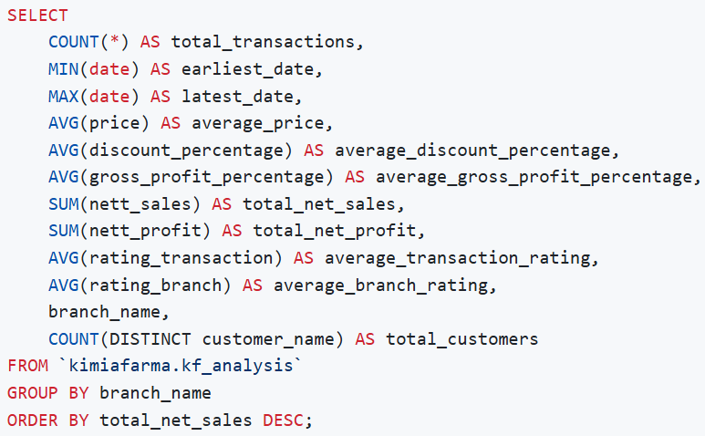
BigQuery Syntax
Exploratory Data Analysis
This BigQuery syntax performs an exploratory data analysis on the kf_analysis table in the kimia_farma dataset. It aggregates various metrics by branch_name, including the total number of transactions, the earliest and latest transaction dates, the average price, discount percentage, and gross profit percentage. Additionally, it calculates the total net sales and net profit, as well as the average transaction and branch ratings. The query also counts the distinct number of customers per branch. Finally, the results are ordered by total net sales in descending order, providing insights into the performance of each branch.
Source : from GitHub Repository, here!

Slide 11
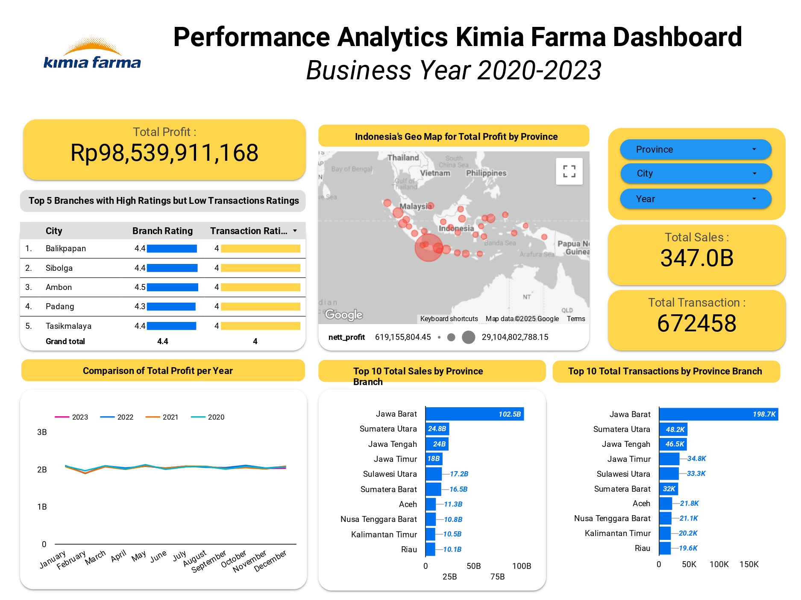
Dashboard Performance Analytics
Source : from Google Looker Studio, here!

Slide 12
Thank You
X

